Slide 1
Puzzle Dots
Team Llama Food
Jeffrey Petersen - Product Owner,
Vanda Pandhumsoporn,
Connor Dunham,
Adam Henry
December 5, 2014
Notes:
Connor

Slide 2
The Project
Puzzle Dots is a web-based game in which colored dots are manipulated to solve puzzles.
The game offers short levels with varying complexity and replayability through finding improved solutions that require less moves.
Written in Javascript and HTML5 with CSS.
Notes:
Vanda

Slide 3
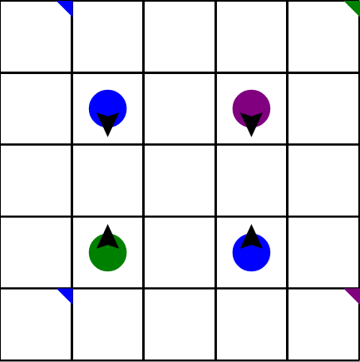
Game Concept
Pieces move simultaneously in groups, where each dot can have a different direction.
When pieces move into each other, different reactions occur.
Forming a new piece through a reaction is called blending.
Reactions between pieces can be learned through experimentation or by reading the rules.
The goal is to pair all pieces and spaces marked with goals by matching colors.
Notes:
Jeffrey

Slide 4
Goals and Challenges
Goals: A fun and challenging game players could enjoy.
A way to share in-game records with other players.
We achieved the first goal, but not the second.
Challenges: Some of us were new to web development.
We encountered cross-browser bugs.
Notes:
Adam

Slide 5
Project Management
Enjoyed
Consistent line of communication
Online Scrum Board
Didn’t Enjoy
Frequency of Scrum Meetings
Fitting meetings into everyone’s schedule
Online meetings
Notes:
Connor

Slide 6
Lessons Learned
Using GitHub allowed us to sync our work remotely.
Lack of a prescribed architecture made feature implementation difficult.
Using UML diagrams in the future would be wise.
Notes:
Adam

Slide 7
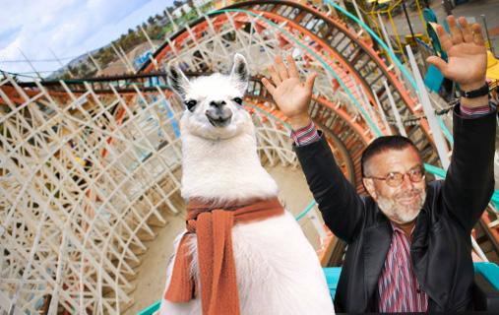
Demo Time!
So Swag!
I love puzzles!
Notes:
Jeffrey

